Slide 1
VIA PASSANA
Daniela Koch
Matej Michalek
Michaela Golhova
Michal Karol Pompa
Remedios Pastor Molines

Slide 2
Agenda
Introduction
Analysis
Design
Implementation
Process
Conclusion

Slide 3



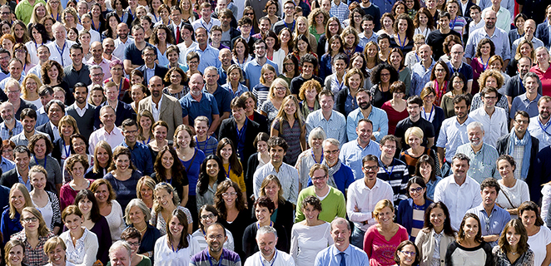
Introduction

Slide 4



Introduction
US
VIA

Slide 5





Slide 7
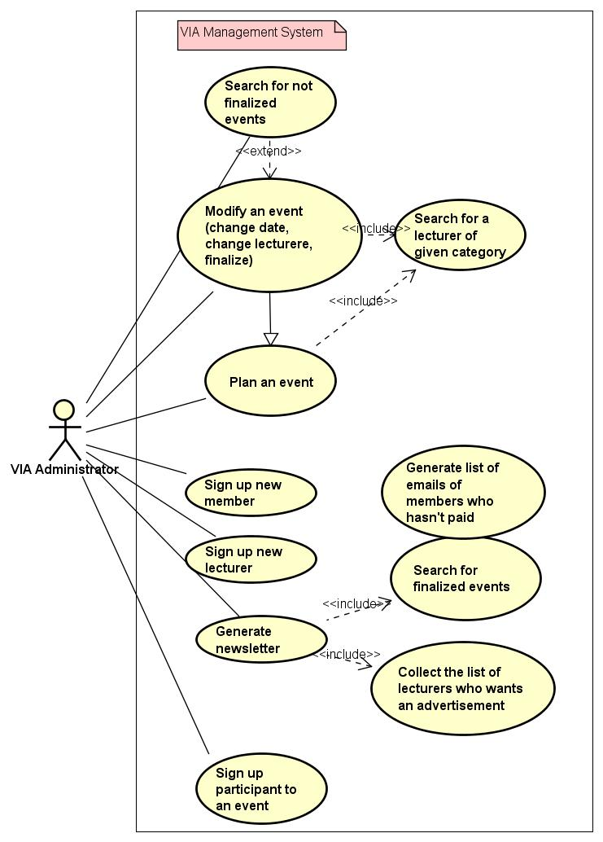

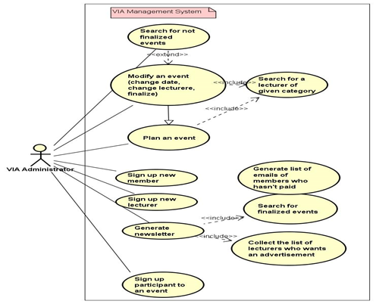
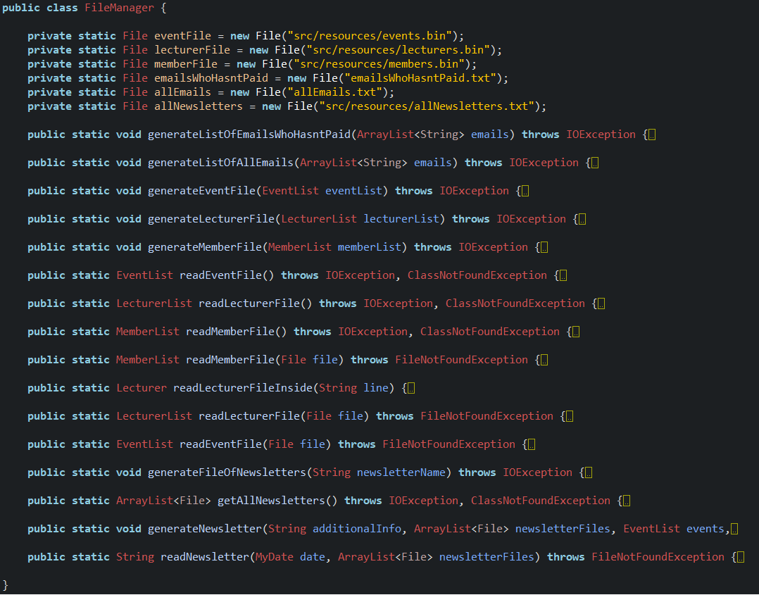
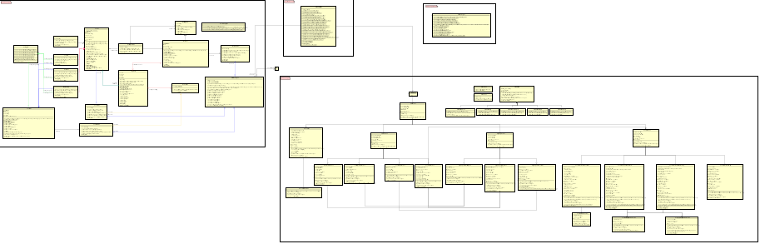

Conclusion (project report)

Slide 8






Conclusion (process report)

Slide 9



Future

